Slide 1
ACID Properties
A transaction is a logical unit of a program, it is an action or series of actions, carried out by user or application, which accesses or changes contents of database.
To preserve data integrity, a database must follow four properties
1) Atomicity: Either all operations of a transaction are reflected or none are reflected
2) Consistency: If a database is consistent before the execution of the transaction, it must be consistent after it
3) Isolation: Although multiple transactions may execute concurrently, each transaction must be unaware of others, i.e., to a transaction, it must seem that either any other transaction has completed execution or has not started execution at all partial effects of incomplete transactions should not be visible to others
4) Durability: After a transaction finishes successfully,(committed transaction) the changes must be permanent in the database despite subsequent failures
Together, these four properties are called the ACID properties

Slide 2
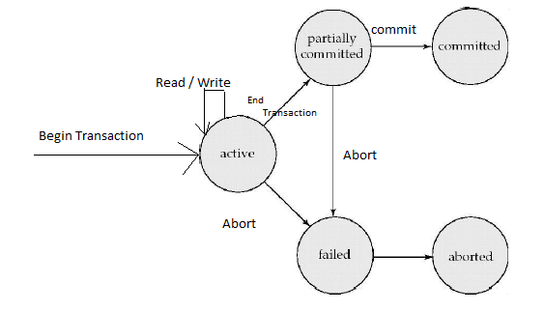
Transaction States
Active: transaction is executing
Partially committed: after last statement has been executed
Failed: when execution cannot proceed
Committed: after successful completion
Aborted: transaction has been rolled back and it has been ensured that there is no effect of the transaction

Slide 3
Transaction Model
A transaction is a logical unit of a program that reads and writes
various named data items
Thus, a database is simply a collection of named items
Granularity of data: field, record, block, relation
Transaction concepts are independent of granularity
Two basic operations: read and write
read(x): reads a database item named x
write(x): writes to a database item named x
Conflicts with read and write
RAW: read-after-write/ Reading uncommitted data/ WR conflict/Dirty Read
WAR: write-after-read/ Unrepeatable reads/RW conflict/Incorrect summary
WAW: write-after-write/Overwriting uncommitted data/WW conflict/Lost update

Slide 4
Problems in transactions
Temporary update or Dirty read: A transaction updates and then fails; another transaction reads it before it is reverted to original value
OR
A transaction works of the data whose entire updation is not complete
T1 T2
r(A)
w(A)
r(A)
w(A)
r(B)
w(B)
commit;
r(B)
w(B)
commit;
T1 – transfers $100 from A to B
T2 – increments both A and B by 6%

Slide 5
Problems in transactions
Incorrect summary: One transaction is updating values while other is computing an aggregate on them
T1 T2
r(A)
r(A)
w(A)
w(A)
A - is number of copies of a book that are available

Slide 6
Problems in transactions
Lost update: Update by one transaction is overwritten by another transaction
T1 T2
w(H)
w(L)
w(L)
w(H)
T1 – writes H and L to $1000
T2 – writes H and L to $2000

Slide 7
Example
Transfer 50 rupees from account a to account b
read(a);
a := a - 50;
write(a);
read(b);
b := b + 50;
write(b)
Atomicity: ‘a’ must not be debited without crediting ‘b’
Consistency: Sum of ‘a’ and ‘b’ remains constant
Isolation: If another transaction reads ‘a’ and ‘b’, it must see one of the
two states: before or after the transaction; otherwise a + b is wrong
Durability: If ‘b’ is notified of credit, it must persist even if the database crashes

Slide 8
Causes of transaction failures
System crash
Memory is lost
System error
Divide by zero
Exceptions
Insufficient account balance
Concurrency enforcement
Deadlock detection
Disk crash
Persistency fails
Physical problems
Power failure, fire

Slide 9
Concurrency
Multiple transactions should be able to run concurrently
Advantages
Increased processor and disk utilization leading to better throughput: one is using CPU, other is doing disk I/O
Reduced average response time: short transactions finish earlier and do not wait behind long ones
Concurrency control schemes achieve isolation
Must ensure correctness of concurrent executions
Serializability imposes notion of correctness

Slide 10
Schedule
A schedule is a chronological sequence of instructions from
concurrent transactions
If a transaction appears in a schedule, all instructions of the
transaction must appear in the schedule
Order of instructions within a transaction must be maintained in the schedule
A transaction finishing successfully will have commit as the last
instruction
A transaction not finishing successfully will have abort as the last
instruction
Commit and abort statements may be omitted if obvious

Slide 11
Example
T1 transfers 50 from A to B and then T2 transfers 10% of A to B
Serial Schedule- S
T1 T2
r1(A);
A := A-50;
w1(A);
r1(B);
B := B + 50;
w1(B);
r2(A);
t := 0.1*A;
A := A-t;
w2(A);
r2(B);
B := B + t;
w2(B);

Slide 12
Example (Contd.)
Concurrent Schedule- S
T1 T2
r1(A);
A := A-50;
w1(A);
r2(A);
t := 0.1*A;
A := A – t;
w2(A);
r1(B);
B := B + 50;
w1(B);
r2(B);
B := B + t;
w2(B);

Slide 13
Serializability
Each transaction preserves database consistency
Hence, a serial schedule also does that
A schedule is serializable if it is equivalent to a serial schedule
There are different forms of equivalence giving rise to notions of
Conflict Serializability
View Serializability
Operations other than read and write are ignored
Instruction Ii of transaction Ti conflicts with Ij of Tj if and only if they
access the same data item and at least one of them is a write
Intuitively, a conflict enforces a logical temporal order of the
instructions
Consequently, if two instructions do not conflict, they can be
interchanged

Slide 14
Conflict Serializability
A schedule S is conflict equivalent to another schedule S’ if it can be transformed to S’ by a series of swaps of non-conflicting instructions
A schedule S is conflict serializable if it is conflict equivalent to some serial schedule S’
A serial schedule is conflict serializable, but not vice versa
If a schedule is conflict serializable, it is correct in the sense that it
preserves database consistency

Slide 15
Example
S : r1(a) w1(a) r2(a) w2(a) r1(b) w1(b) r2(b) w2(b)
S T1 T2
r1(a)
w1(a)
r2(a)
w2(a)
r1(b)
w1(b)
r2(b)
w2(b)
is conflict serializable as it is conflict equivalent to the serial schedule
T1T2 : r1(a) w1(a) r1(b) w1(b) r2(a) w2(a) r2(b) w2(b)
It is not required to be conflict equivalent to T2T1 as well

Slide 16
Example (Contd.)
S : r1(a) w2(a) w1(a)
S T1 T2
r1(a)
w2(a)
w1(a)
is not conflict serializable as it is not conflict equivalent to either of the two serial schedules T1T2 and T2T1
TIT2: r1(a) w1(a) w2(a)
T2T1: w2(a) r1(a) w1(a)

Slide 17
View Serializability
Two schedules are view equivalent if the reads in them get the same
“view”, i.e., they read the value produced by the same write operation
Formally, two schedules S and S’ are view equivalent if
1.For each data item x, if a transaction T reads the initial value of x in S,
it reads the same initial value of x in S’ as well
2.For each data item x, if a transaction T writes the final value of x in S,
it writes the final value of a in S’ as well
3. If transaction Ti reads the value of data item x produced by write
action of transaction Tj in S, it must read the value written by Tj in S’
as well
A schedule S is view serializable if it is view equivalent to a serial
schedule

Slide 18
Example
S : r1(a) w1(a) r2(a) w2(a) r1(b) w1(b) r2(b) w2(b)
S T1 T2
r1(a)
w1(a)
r2(a)
w2(a)
r1(b)
w1(b)
r2(b)
w2(b)
is view serializable as it is view equivalent to the serial schedule
T1T2 : r1(a) w1(a) r1(b) w1(b) r2(a) w2(a) r2(b) w2(b)

Slide 19
Example
S: r1(a) w2(a) w1(a) w3(a)
is view serializable as it is view equivalent to the serial schedule
T1T2T3 : r1(a)w1(a)w2(a)w3(a)
S: r1(a) w2(a) w1(a)
is not view serializable as it is not view equivalent to either of the two serial schedules
T1T2 (final writes are not same) and
T2T1 (T1 is not reading the same initial value of object a in both the schedules)

Slide 20
Relationship between View and Conflict Serializability
Every conflict serializable schedule is view serializable, but not vice
versa
Conflict Serializability is stricter than View Serializability
They are same under the constrained write assumption
In this assumption, every write of a data item x is constrained by the
value of x it has read
write(f(read(x)))
With unconstrained writes (blind writes), a schedule that is view
serializable is not necessarily conflict serializable
Blind writes: writes to a data item without reading it
Every view serializable schedule that is not conflict serializable must
have blind writes

Slide 21
Example
S: r1(a) w2(a) w1(a) w3(a)
is view serializable as it is view equivalent to the serial schedule
T1T2T3 : r1(a)w1(a)w2(a)w3(a)
But it is not conflict serializable, because it is not conflict equivalent
to any serial schedule

Slide 22
Testing For Serializability
Create a precedence graph for the schedule
Directed graph where each transaction is a vertex
An edge from transaction Ti to Tj exists if
w_{i}(x) precedes r_{j}(x), or
r_{i}(x) precedes w_{j}(x), or
w_{i}(x) precedes w_{j}(x)
A schedule is conflict serializable if and only if its precedence graph is acyclic

Slide 23
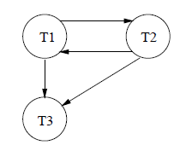
Precedence Graph Example 1
T1 T2 T3
R(A)
W(A)
commit
W(A)
commit
W(A)
commit

Slide 24
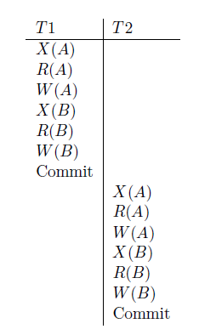

Precedence Graph Example 2

Slide 25
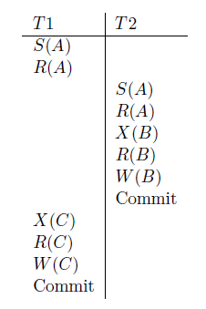

Precedence Graph Example 3

Slide 26
Recoverable Schedule
Conflict and View Serializability do not address failures
Order of commits and aborts are important
A schedule is called a recoverable schedule if
A transaction Ti reads a data item previously written by Tj , and
Tj commits before Ti commits
Consider S: r1(a) w1(a) r2(a) r1(b)
If T2 commits just after r2(a), i.e., if the schedule is
S: r1(a) w1(a) r2(a) c2 r1(b) a1, then it is not recoverable
If T1 crashes, then w1(a) is undone, but T2 has already read a wrong
value of a and committed
Therefore, to make it recoverable, the schedule should be
S: r1(a) w1(a) r2(a) r1(b) c1 c2
If T1 aborts, T2 can also abort

Slide 27
Cascading Rollbacks
In recoverable schedules, a single transaction failure may lead to a
series of rollbacks of other transactions
This is called cascading rollbacks or cascading aborts
Consider , S: r1(a) w1(a) r2(a) w2(a) r3(a) r1(b) a1 c2 c3
It is recoverable
However, if T1 fails, T2 and T3 must abort as well
Not preferable as lot of work is undone

Slide 28
Cascadeless Schedule
Cascading rollbacks are eliminated
A schedule is called a cascadeless schedule if
A transaction Ti reads a data item previously written by Tj , and
Tj commits before Ti reads
Consider S: r1(a) w1(a) r2(a) r1(b) a1 c2
It is not cascadeless as T2 reads ‘a’ written by T1 before T1 commits
Therefore, to make it cascadeless, the schedule should be
S: r1(a) w1(a) r1(b) c1 r2(a) c2
No completed transaction needs to be rolled back
Every cascadeless schedule is recoverable, but not vice versa

Slide 29
Strict Schedule
Problem of writes remains in the sense that a later transaction may overwrite an uncommitted write
A schedule is called a strict schedule if
A transaction Ti reads or writes a data item previously written by Tj , and
Tj commits before Ti reads or writes
Consider S: r1(a) w1(a) w2(a) r1(b) a1 c2
It is not strict as T2 writes a written by T1 before T1 commits
Therefore, to make it strict, the schedule should be
S: r1(a) w1(a) r1(b) c1 w2(a) c2
Every strict schedule is cascadeless, but not vice versa

Slide 30
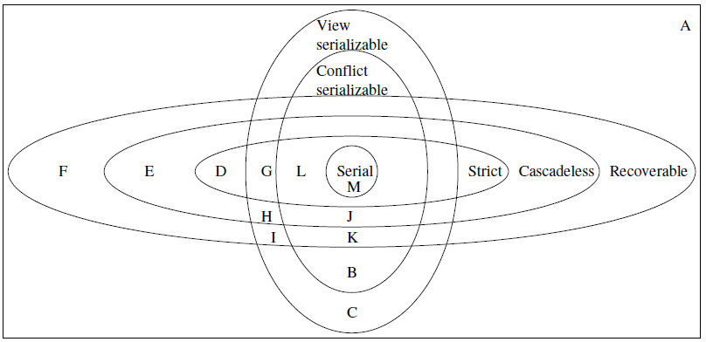
Relationship between schedules

